Slide 1

Sport of Navigation
events accessibility
via Calgary public transit
for college/university students

Slide 2
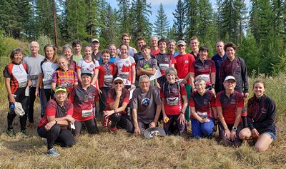
Foothills Wanderers Orienteering Club
was founded in 1977 and provides navigation sport events and training
to people of all ages, identities, and abilities
in Calgary and surrounding areas
https://orienteeringcalgary.ca/.

Slide 3
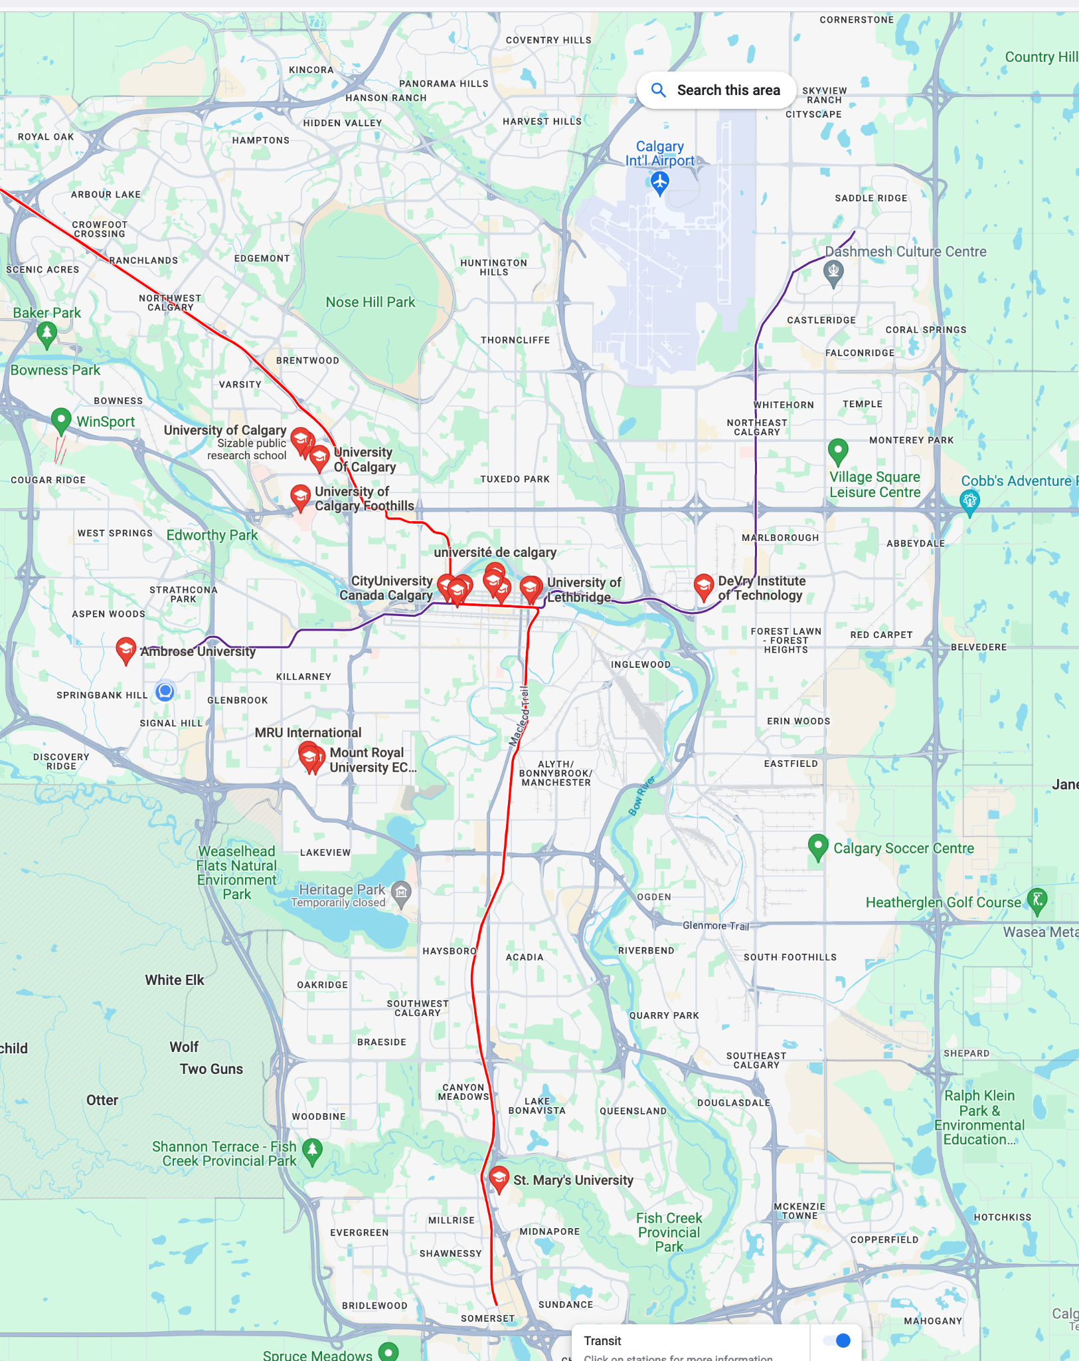
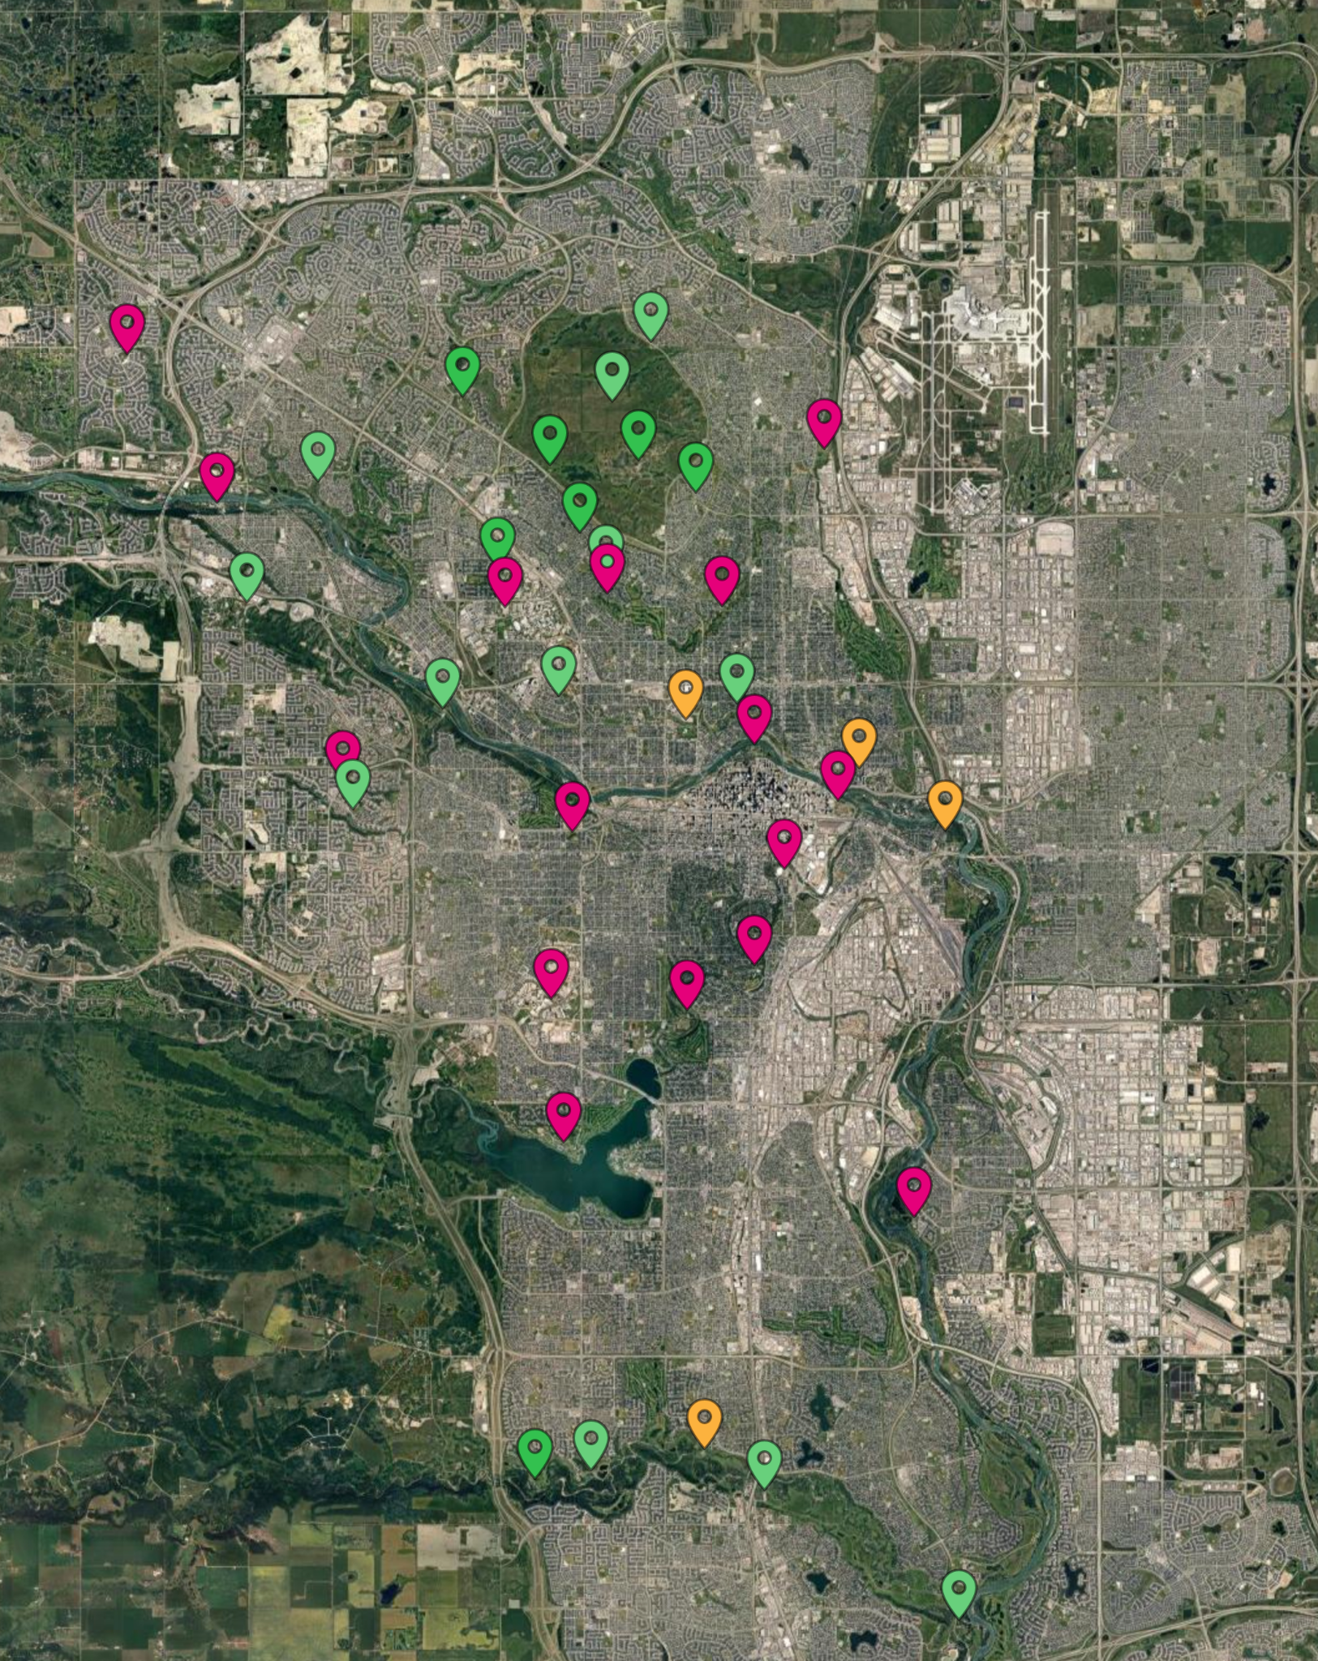
Datasets:
1.Universities+Public Transit 2.Navigation Sport Events

Slide 4

The goal
Microproject
analyse how accessible are Calgary navigation sport events locations
for example from the campuses using public transit data
to support universities/colleges which may have a need for outdoor activities
data skills to get insights from public datasets
1-3 people
Notes:
Create experiences for college/university students to explore their passion for nature, physical activity, and mental challenge.
Build confident, resilient people through recreational and competitive sport of navigation(sport of orienteering) events, coaching, training, and social opportunities in a fun, respectful, safe and environmentally friendly manner.
1. We have a gap in the young adults age group participation in the orienteering sport in Calgary. (Actually the first step would be to analyze how large the gap is and confirm this statement based on our data).
2. Our hypothesis is that students of universities in Calgary do not have access to this sport. (I know it's pretty popular for students in Europe and Nordic countries, we can try to do a comparison for the data available for Calgary, Alberta and Canada overall).
3. The opportunity is to find universities/colleges which may have a need for outdoor sport activities for students based on their data. And/or see how accessible are Calgary foothills wanderers orienteering club sport events/maps locations from the campuses for example using public transit data.

Slide 5
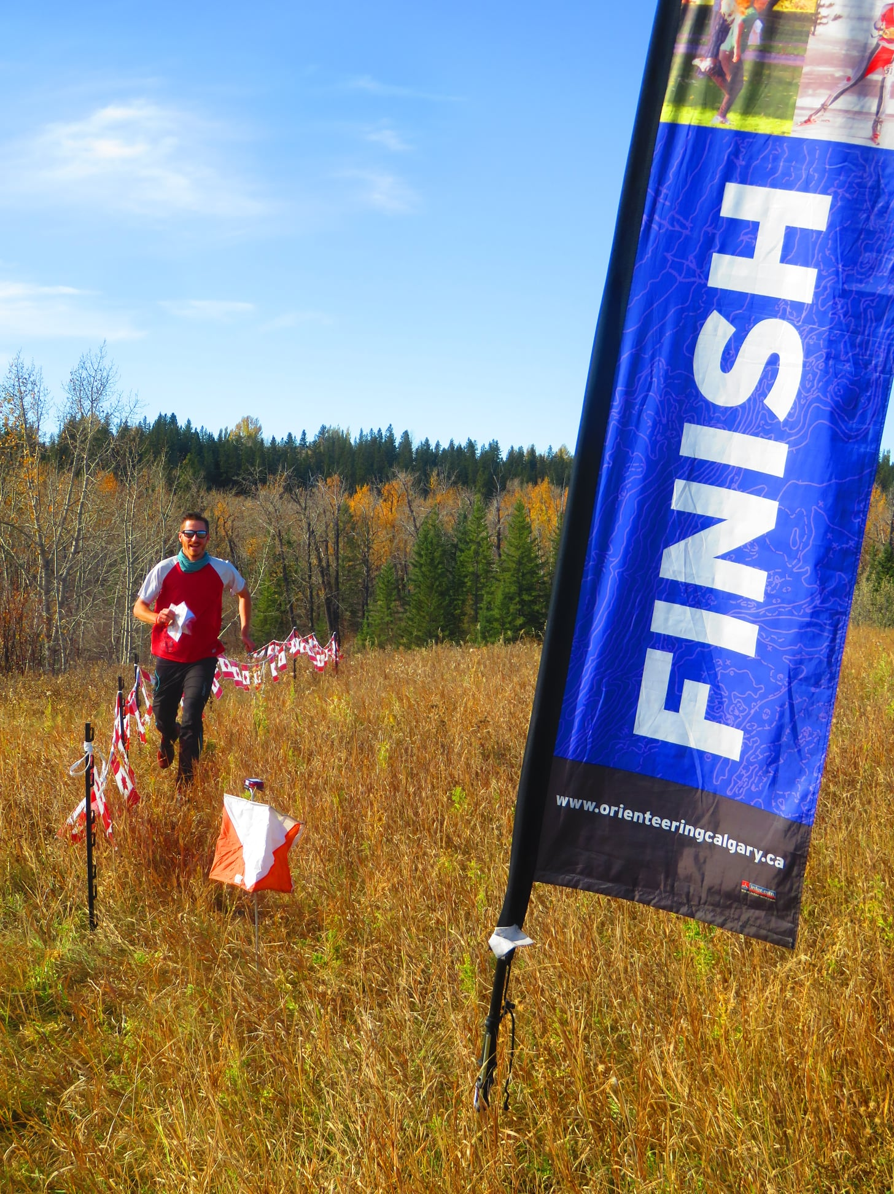
Thank you!

